Slide 1
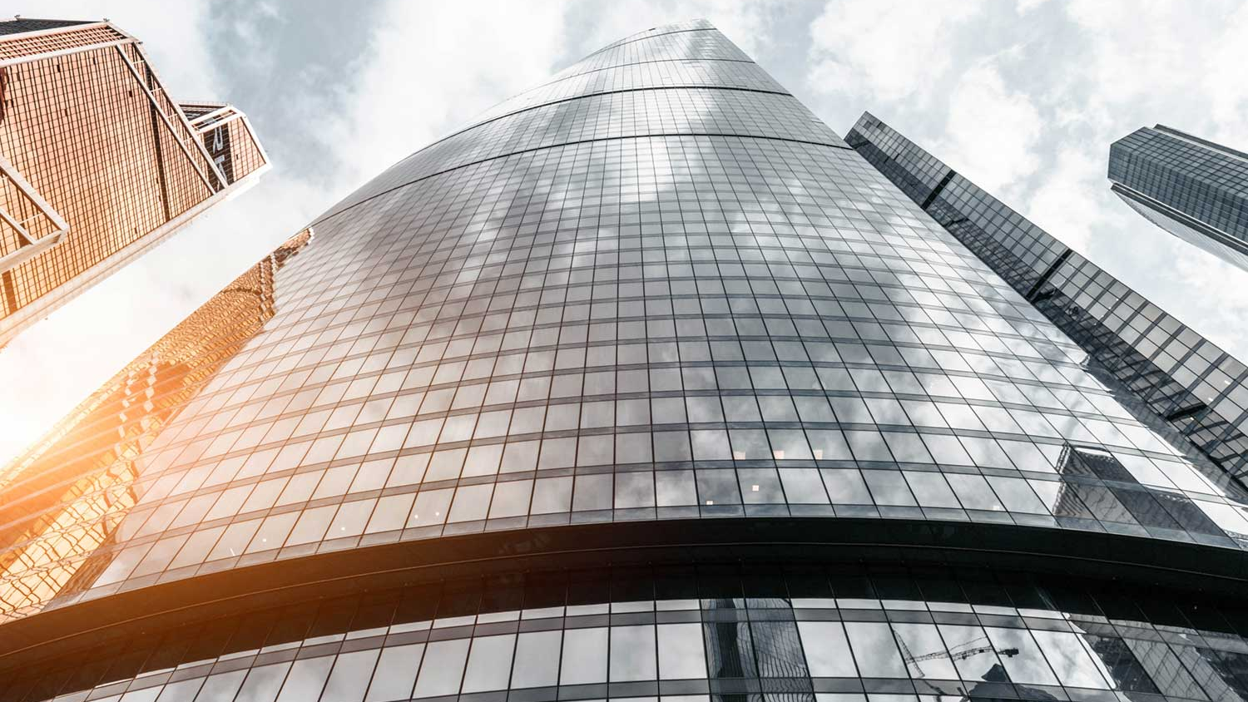
Bright motor car dealership
Sales And Revenue Analysis
By Hlengiwe

Slide 2
Sales analysis by car make
. Ford is the mostly sold car followed by Chevrolet then BMW
. The stock of these cars needs to be increased as they are on demand
. Volvo, Meserati and Mini are poorly perfoming
. Theirs stock needs to be reducesd cause they are not contributing to total sales

Slide 3
Sales By Car Model
. Fiesta is the best selling followed by X6 then Mastang
. Spark, QX60 and Cayman are poorly perfoming

Slide 4
Sales By Transmission
.The best selling car transmission is automatinc followed by others then manual
. Automatic car stock needs to be increased as it is highly on demand

Slide 5
Sales By Color
. White car is best selling followed by black then gray
. The stock of these colors needs to be increases
. Orange, gold and burgundy are less selling colors
. Their stock cn be reduces as they are not in demand

Slide 6
Sales By Interior
. Point black interior is highly sold followed by poing gray then point tan interior
. The stock of the above interiors needs to be increased
. Stock of less sold interior needs to be reduced

Slide 7
Sales By Year
. Year 2014 was the best selling followed by 2013 then 2012
. 2003, 2004 and 2005 are poorly perfoming on sales their stock needs to be reduced.
.Stock of best selling years needs to be increased

Slide 8
Revenue By Make
. BMW generates more revenue followed by Ford then Mercedec Benz
. The stock of these cars needs to be increased and expand its promotion
. Mitsubish, Mini and Mercury do not generate any revenue
. Their stock need to be removed its not generating any revenue at all

Slide 9
. Revenue By Model
. SUPERDUTY generates more revenue followed by X6 then Mustang SVT
. Their stock needs to be increased and expand its promotion
. Stock of poor pefoming cars like C-class, Camaro and Mazda3 needs to be reduced

Slide 10
Revenue By Color
Color that generates more revenue is white, followed by black then gray
. The stock of these colors needs to be increased as they generate more revenue
. Purple, Off=white and charcoal color stock needs to be removed as they are not generating any revenue

Slide 11
Revenue By Interior
. Black, gray and gold interior generates more revenue their stock needs to be expanded and promoted more
. Reduce the stock of poor perfoming interior like off-white, orange and purple they are not on demand

Slide 12
Revenue By Year
. 2014, 2012 and 2015 generates more revenue , theirs stock needs to be expanded.
. Poorly perfoming years like 1982 to 2002 stock needs to be removed as it generates no revenue at all

Slide 13
Revenue By Transmission
.Automatic transmission generates more revenue about 83%
. Automatic car stock needs to be increased
. Manual cars generates less revenue only 5% of total revenue
.Manual car stock needs to be reduced as it is not on demand

